Slide 1
John Wesley & Virtue Ethics A result of moral courage Jennifer Wheeler

Slide 2
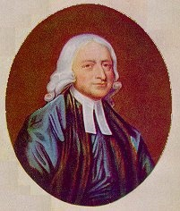

Slide 3
Life in Epworth England 1700’s

Slide 4
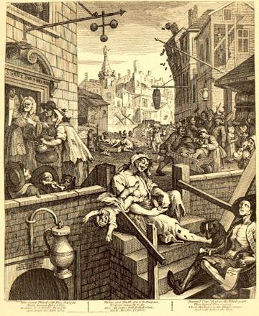

Slide 5
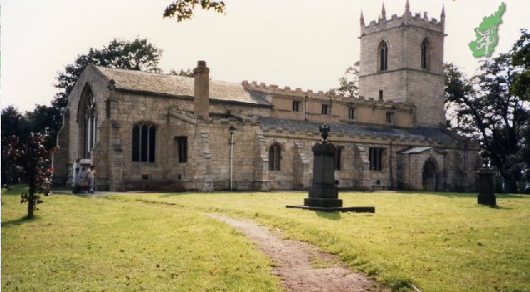
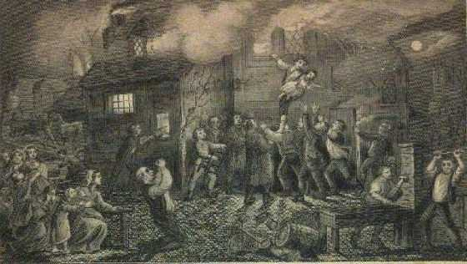
The Epworth Rectory

Slide 6
Charterhouse School London : 1611

Slide 7
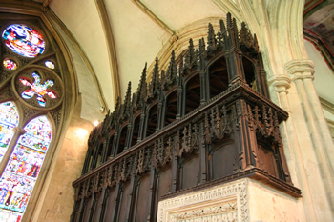
Christ Church College in Oxford England

Slide 8
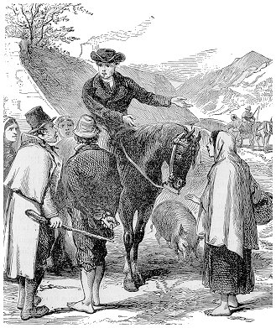
www.christianarrowhead.org.uk/files/jwesleyr.jpg

Slide 9
Preaching to the Indians in Georgia 1736
screenheritage.files.wordpress.com

Slide 10
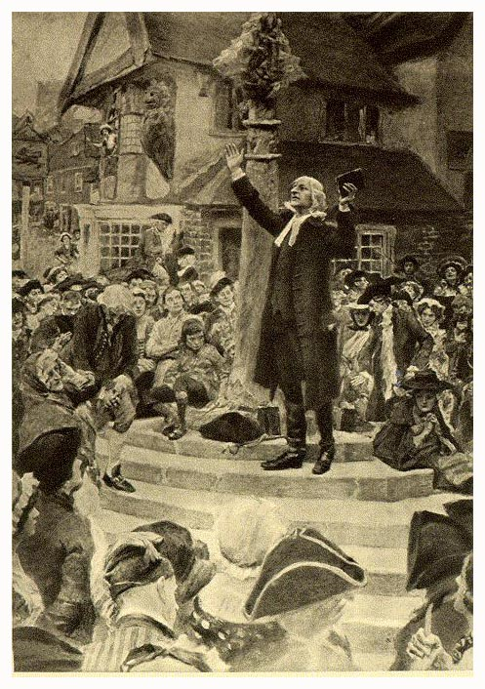
Teaching to the Masses
Virtue
Wqua Ethics

Slide 11
Virtue ethics principles:
Rules
The Ten Commandments
Golden Rule
Put on the armor of God and stand fast.
Results
Care, feed and cloth poor
Visit the sick, dying and imprisoned
Bring about justice
Educate the masses
Eradicate slavery.
Help your neighbor
Walk in a manner worthy of your calling (Phil 1:27)
Put others first. (Phil 2:4)

Slide 12
What motivates your ethical response?
Emotion?
Expediency?
Consequence?
Rules / Laws
Situation

Slide 13
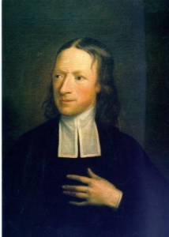
The Wesley method of decision-making
Will my decision compromise my faith in God?
Will it compromise my moral principles?
How will my decision affect others for the greater good?
Is this a just and fair decision to the majority involved?
How will it affect who I am?
Is it reasonable?
John Wesley, by Robert Hunter, 1765

Slide 14
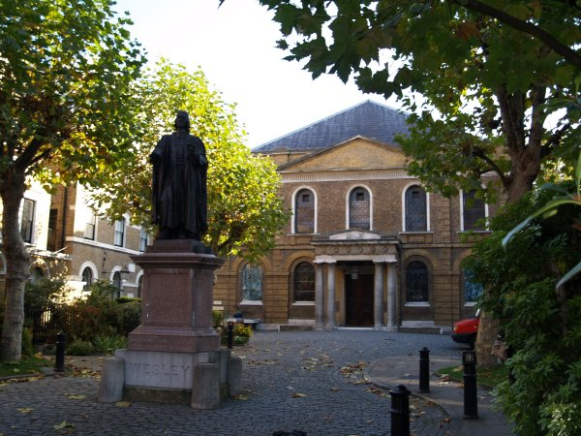

Slide 15
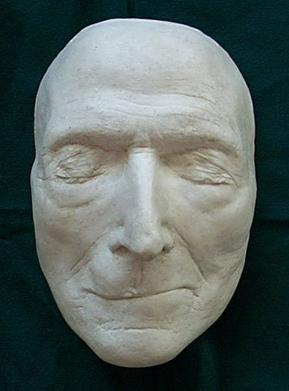
Do all the good you can, by all the means you can, in all the ways you can, in all the places you can, at all the times you can, to all the people you can, as long as ever you can.

Slide 16
Bibliography
Literary Sources
Curnock, Nehemiah The Journal Of John Wesley. New York: Capricorn Books, 1999
Lyerly, Cynthia Methodism and the Southern Mind. New York: Oxford Press,1998
Yrigonyen, Charles Holiness of Heart and Mind. Nashville TN: Abington Press, 2007
Internet Sources:
http://www.library.manchester.ac.uk/specialcollections/exhibitions/web/johnwesley (accessed 9/15/08)
http://gbgm-umc.org/umhistory/wesley/index.html (accessed 9/17/08)
http://www.tlogical.net/biojwesley.htm (accessed (9/12/08)
http:// grubstret.rictornorton.co.uk (accessed (9/13/09)

